Slide 1
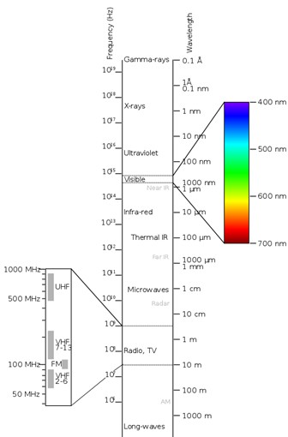
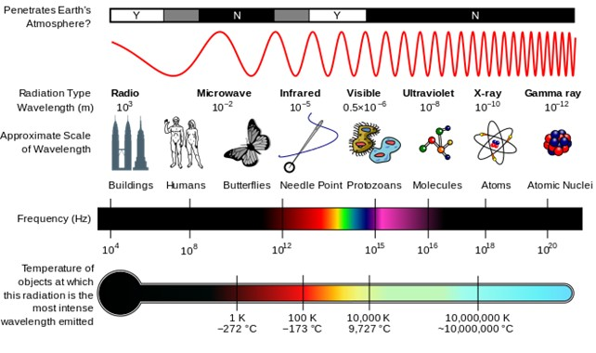
X-Ray Diffraction
Diffraction gratings must have spacings comparable to the wavelength of diffracted radiation.
Can’t resolve spacings < λ
Spacing is the distance between parallel planes of atoms.

Slide 2
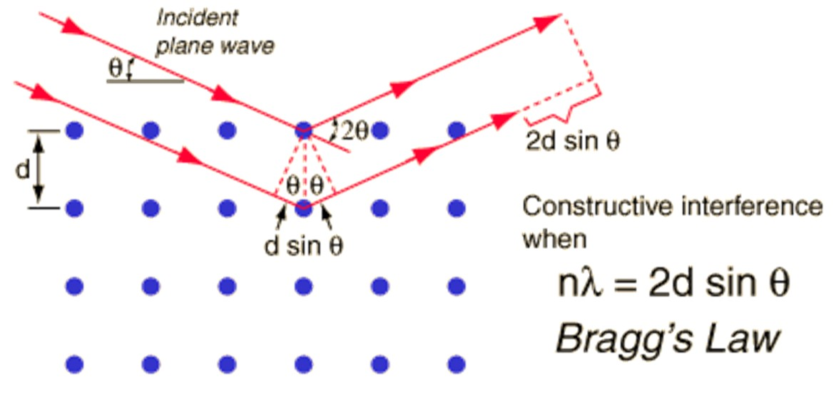
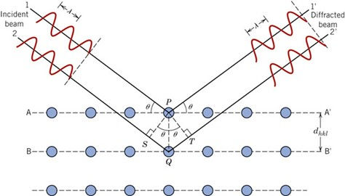
f19_03_pg68
Notes:
f19_03_pg68.jpg

Slide 3
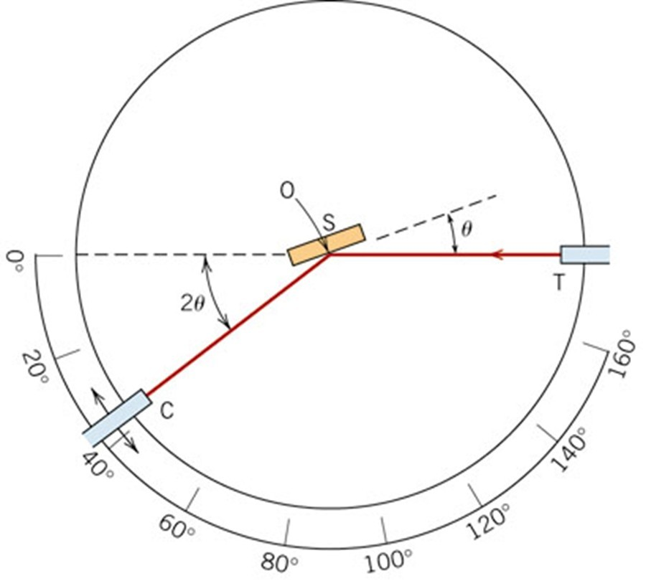
f20_03_pg69
Notes:
f20_03_pg69.jpg

Slide 4
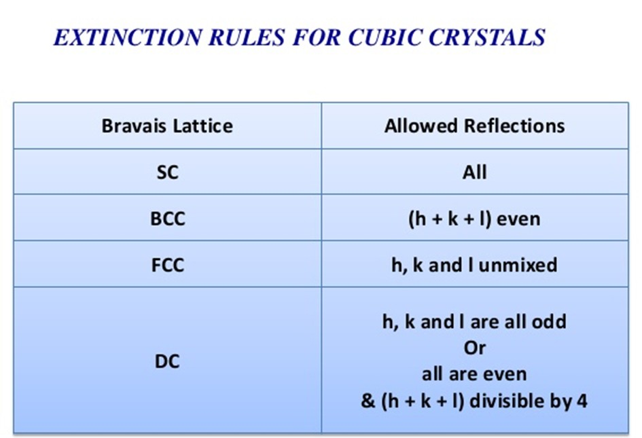
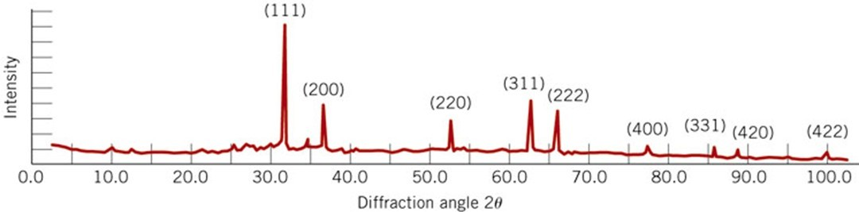
f21_03_pg70
Notes:
f21_03_pg70.jpg

Slide 5
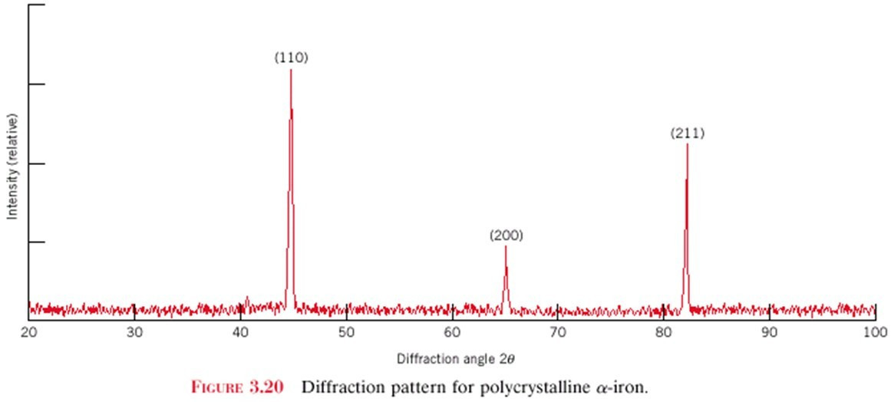
X-Ray Diffraction Pattern
z
z
z
c
c
c
y
(110)
y
y
a
b
a
b
a
b
x
x
x
(211)
Intensity (relative)
(200)
Diffraction angle 2θ
Diffraction pattern for polycrystalline α-iron (BCC)

Slide 6
Imperfections in Solids
There is no such thing as a perfect crystal.
What are these imperfections?
Why are they important?
Many of the important properties of materials are due to the presence of imperfections.

Slide 7
Types of Imperfections
• Vacancy, Self interstitials
• Impurity atoms
Interstitial
Substitutional
Point defects
• Dislocations
Line defects
• Grain Boundaries,
Stacking Faults,
Twin Boundaries
Anti Phase Boundaries
Area defects
• Pores, blow holes
Pin holes
Volume defects

Slide 8
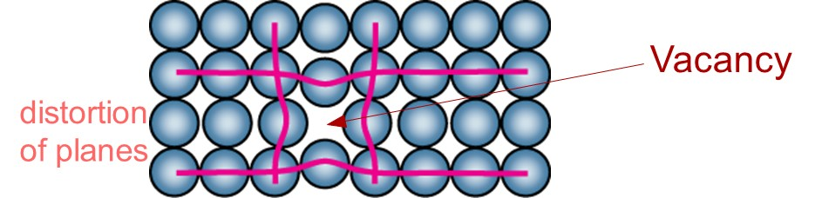
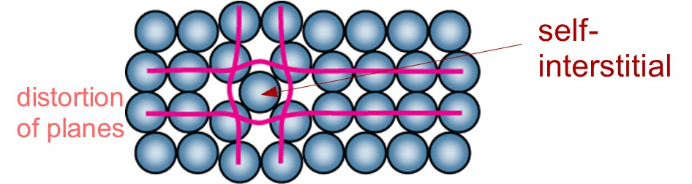
Point Defects
• Vacancies:
-vacant atomic sites in a structure.
• Self-Interstitials:
-"extra" atoms positioned between atomic sites (voids).

Slide 9
Equilibrium Concentration: Point Defects
• Equilibrium concentration varies with temperature!
No. of defects
Activation energy
⎛
−
⎞
N
v
⎜
Q
v
=
exp
⎜
No. of potential
⎝
⎠
N
k
T
defect sites.
Temperature
Boltzmann's constant
(1.38 x 10
-23
J/atom-K)
(8.62
x
10
-5
eV/atom-K)
Each lattice site
For most metals, the fraction of vacancies N_{v}/N just below the melting temperature is on the order of 10⁴; that is, one lattice site out of 10,000 will be empty
is a potential
vacancy site

Slide 10
Measuring Activation Energy
⎛
−
⎞
• We can get Q_{v} from
an experiment.
N
v
⎜
Q
v
⎟
=
exp
⎜
⎟
N
⎝
k
T
⎠
• Measure this...
• Replot it...
N
v
N
slope
v
ln
N
N
-
Q
v
/k
exponential
dependence!
T
1/
T
defect concentration

Slide 11
Estimating Vacancy Concentration
• Find the equil. # of vacancies in 1 m³ of Cu at 1000°C.
• Given:
ρ
= 8.4 g
/
cm
3
A
= 63.5 g/mol
Cu
Q
v
= 0.9 eV/atom
N
A
= 6.02 x 10²³
atoms/mol
0.9 eV/atom
⎛
−
⎞
N
v
⎜
Q
v
⎟
=
exp
⎜
⎟
= 2.7 x 10⁻⁴
N
⎝
k
T
⎠
1273K
8.62 x 10⁻⁵
eV/atom-K
N
A
For 1 m³
, N =
ρ
x
x
1 m³
= 8.0 x 10²⁸ sites
A
Cu
• Answer:
N
v
=
(2.7 x 10⁻⁴)(8.0 x 10²⁸) sites = 2.2 x 10²⁵ vacancies

Slide 12

Diffusive migration of vacancies on Ge surface as observed through scanning tunneling microscope

Slide 13
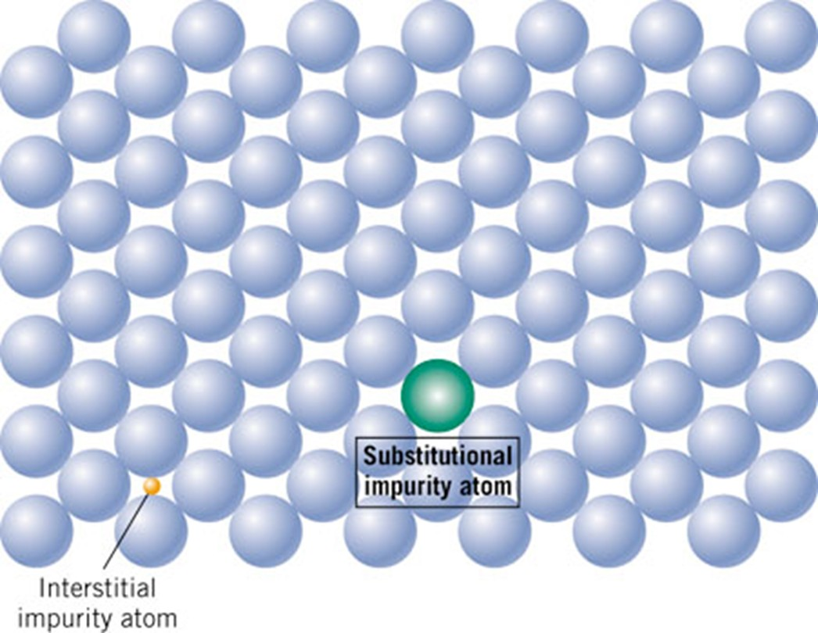
f02_04_pg5
Impurity Atoms
Notes:
f02_04_pg5.jpg

Slide 14
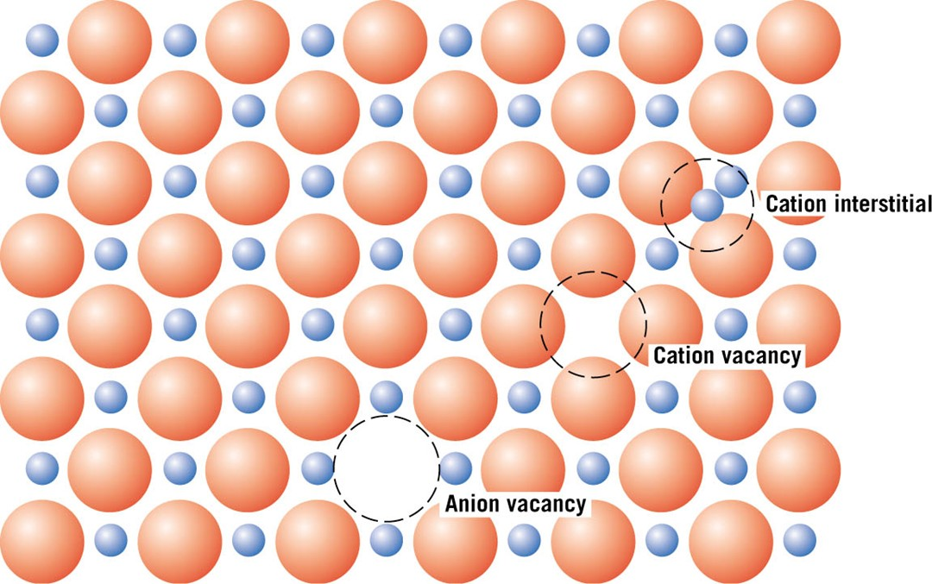
f12_20_pg434
Defects in Ceramic Structures
Notes:
f12_20_pg434.jpg

Slide 15
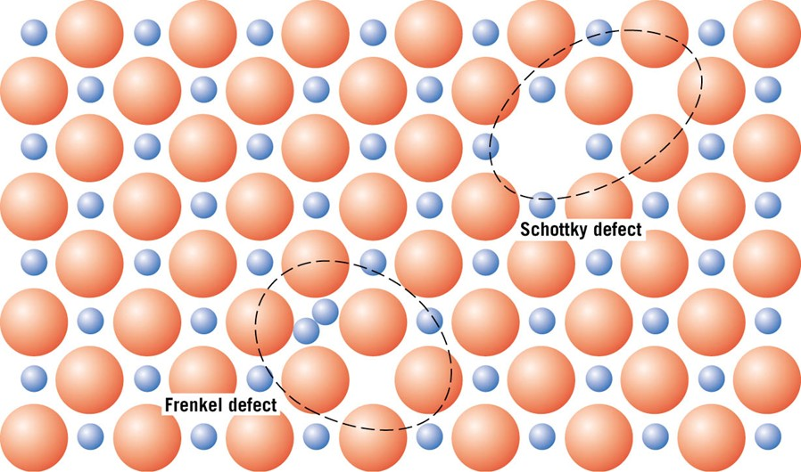
f12_21_pg435
Defects in Ceramic Structures
• Frenkel Defect
A cation is out of place.
• Schottky Defect
A paired set of cation and anion vacancies.
Notes:
f12_21_pg435.jpg

Slide 16
Impurities
• Impurities must also satisfy charge balance = Electroneutrality
• Ex: NaCl
Na
+
Cl
-
• Substitutional cation impurity
cation
vacancy
Ca
2+
Na
+
Na
+
Ca
2+
initial geometry
Ca
2+
impurity
resulting geometry
• Substitutional anion impurity
anion vacancy
O
2-
Cl
-
Cl
-
initial geometry
O
2-
impurity
resulting geometry

Slide 17
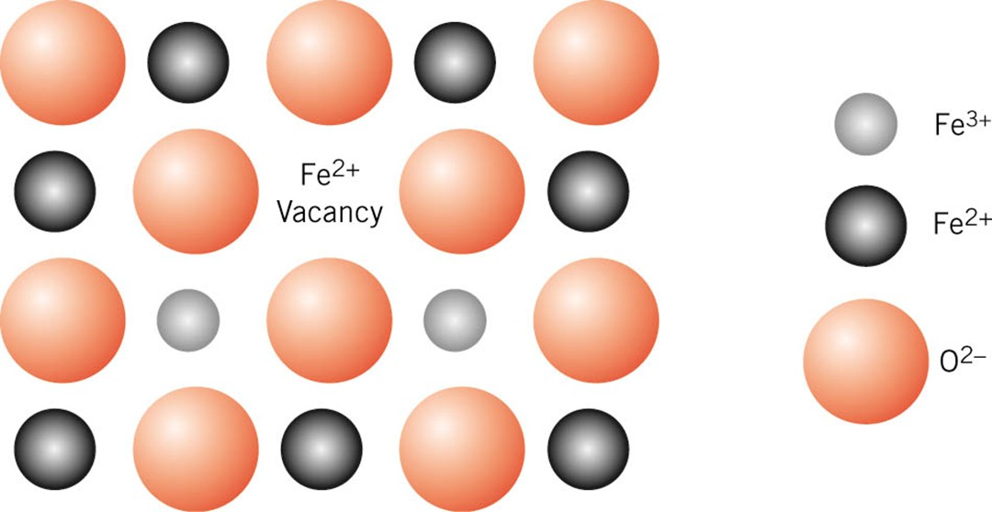
f12_22_pg435
Non Stoichiometric compound
Notes:
f12_22_pg435.jpg

Slide 18
Linear (1d) defects in crystals: Dislocations Non-equilibrium defects and would leave the crystal if given an opportunity.

Slide 19
Role of Dislocations
Kinetics
Deformation Processes
Creep
Diffusion (Pipe)
Fatigue
Crystal Growth (Screw dislocation)
Fracture
Slip
Structural
Incoherent Twin
Grain boundary (low angle)
Cross
-
slip
Semicoherent Interfaces
Creep
Dislocation climb
Disc of vacancies ~ edge dislocation
mechanisms in
crystalline
Vacancy diffusion
and more…!!
materials
Grain boundary sliding
Note: Structural dislocations can also play a role in deformation and kinetic processes

Slide 20
Dislocation can be considered as a boundary between the slipped and the unslipped parts of the crystal lying over a slip plane*
Slipped part of the crystal
Unslipped part of the crystal
* this is just a way of visualization and often the slipped and unslipped regions may not be distinguished

Slide 21
A dislocation has associated with it two vectors:
The Burgers vector is the shortest lattice translation vector for a full/perfect dislocation)
It defines every aspect of the dislocation (its stress fields, energy, etc.) and expresses itself even in the ‘death’ of the dislocation (i.e. when the dislocation leaves the crystal and creates a step of height ‘b’).
Burgers vector can be determined by the Burgers circuit (coming up).

Slide 22
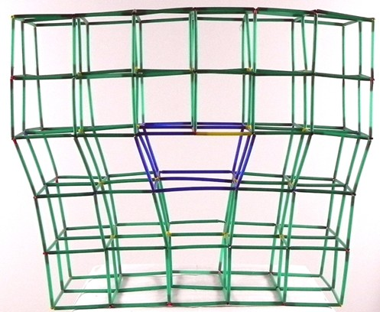
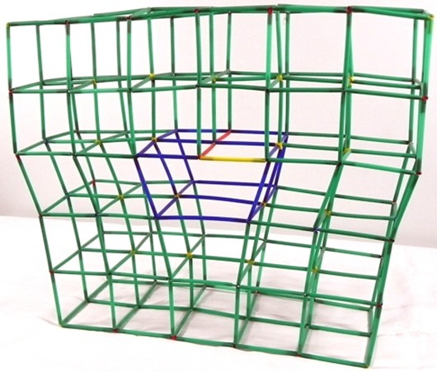
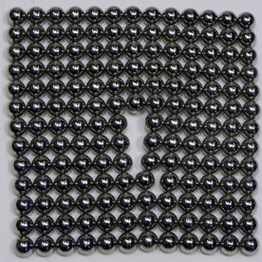
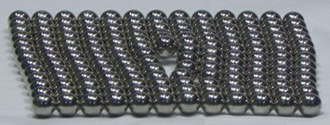
Some models of Edge Dislocation
Model using magnetic balls (not that accurate!)

Slide 23
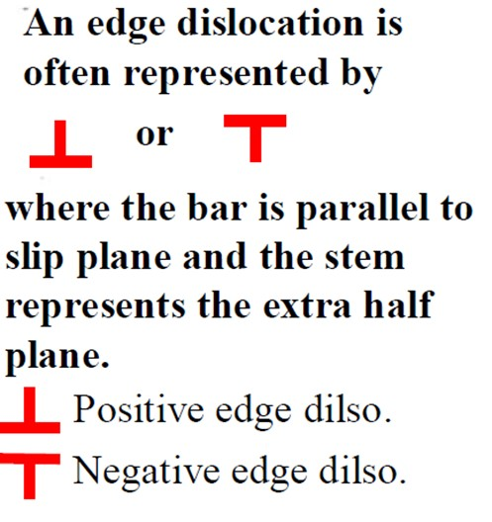
Edge dislocation
Often to visualize the edge dislocation, only the extra ‘half’-plane and slip plane are shown. The remaining crystal is hidden away.
The intersection of the extra half-plane and slip plane can be visualized as the dislocation line.

Slide 24
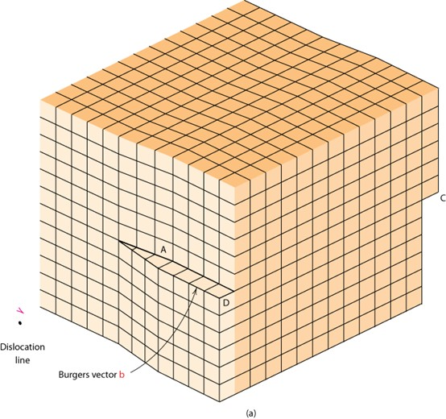
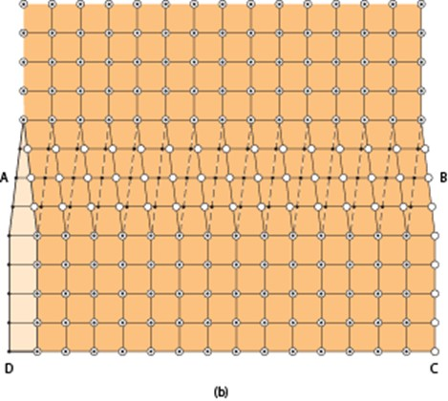
Screw Dislocation
Comprises a structure in which a helical path is traced around the linear defect (dislocation line) by the atomic planes of atoms in the crystal lattice
Screw Dislocation
Dislocation
line
b
Burgers vector b
(b)
(a)

Slide 25
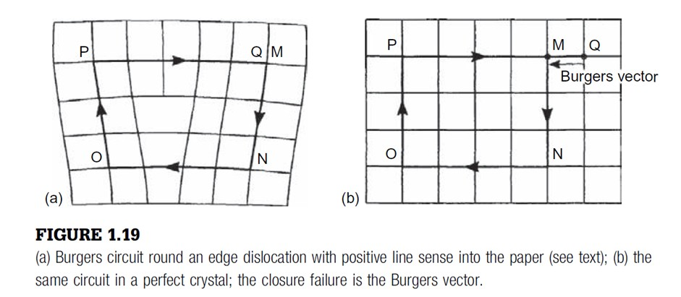
Burgers circuit
A Burgers circuit in a crystal containing dislocations is an atom-to-atom
path which forms a closed loop. -- in Fig. 1.19(a), MNOPQ.
If the same atom-to-atom sequence is made in a dislocation free crystal, Figure 1.19(b), and the circuit does not close, then the first circuit, Fig. 1.19(a), must enclose one or more dislocations.
The vector required to complete the circuit is called the Burgers vector.
Edge dislocation

Slide 26
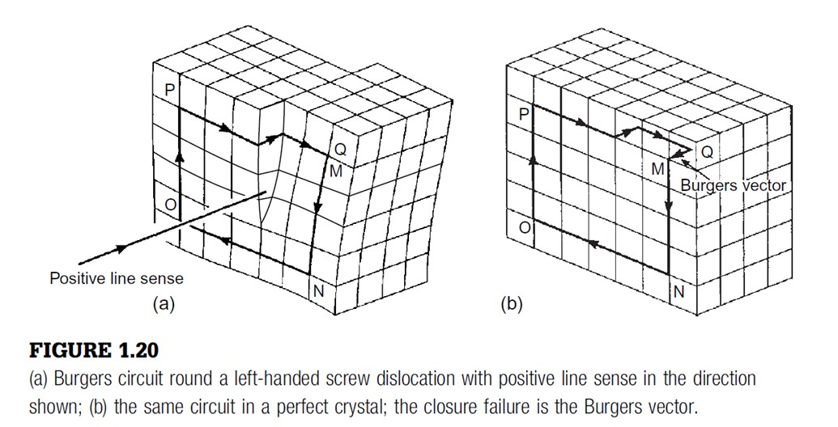
Burgers circuit
Screw dislocation
When the Burgers circuit is drawn round a screw dislocation (Fig. 1.20), with a closed circuit in the crystal containing the dislocation,
Closure failure in the perfect crystal is given by vector QM
Burgers vector QM is parallel to the dislocation line.

Slide 27
Rules for construction of Burgers circuit
When looking along the dislocation line, which defines the positive line sense or direction of the dislocation, the circuit is taken in a clockwise fashion (Figs 1.19(a), 1.20(a)).
The Burgers vector is taken to run from the finish to the start point of the reference circuit in the perfect crystal.
This defines the right-hand/finish start (RH/FS) convention.

Slide 28
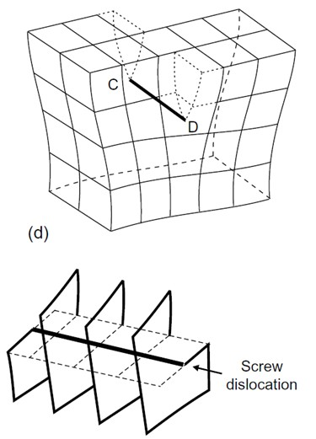
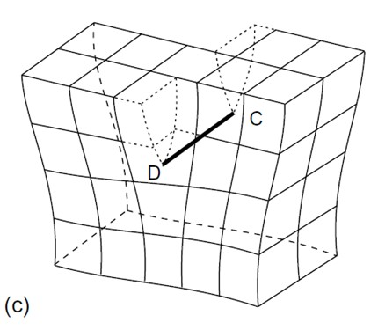
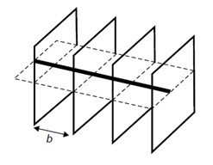
Looking down the dislocation line, if the helix advances one plane when a clockwise circuit is made round it (Fig. 18(d)), it is referred to as a right-handed screw dislocation, and if the reverse is true it is left-handed.
Right-handed screw dislocation
Left-handed screw dislocation

Slide 29
More about Burgers vector
Reversing the line sense reverses the direction of the Burgers vector for a given dislocation.
Dislocations with the same line sense but opposite Burgers vectors (or alternatively with opposite line senses and the same Burgers vector) are physical opposites, in that if one is a positive edge, the other is a negative edge, and if one is a right handed screw, the other is left-handed.
Dislocations which are physical opposites of each other annihilate and restore perfect crystal if brought together.

Slide 30
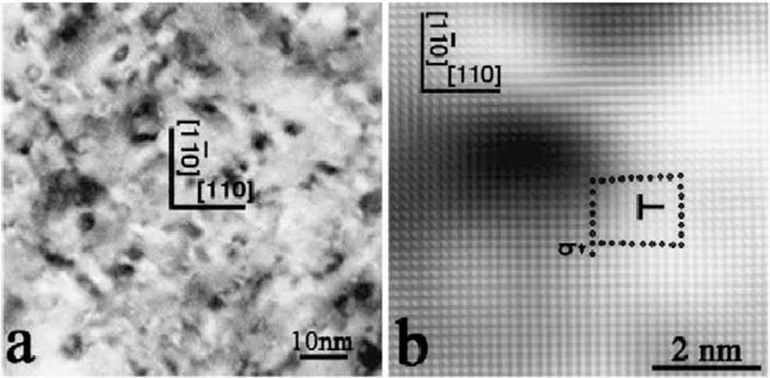
TEM image of edge dislocation in Cu crystal. The Burgers circuit around the dislocation line can be clearly observed.

Slide 31
Geometric properties of dislocations
In a edge dislocation : b is perpendicular to t.
In a screw dislocation : b is parallel to t.
Other properties are as in the table below.
Dislocation Property | Type of dislocation
 | Edge | Screw
Relation between dislocation line (t) and b | ⊥ | ||
Slip direction** (& the ‘direction’ of step created when dislocation leaves the crystal) | || to b | || to b
Direction of dislocation line movement relative to b | || | ⊥
Process by which dislocation may leave slip plane* | climb | Cross-slip
* Note: edge dislocations cannot cross slip & screw dislocations cannot climb.
** Slip is the end result when dislocation leaves the crystal to create a step. Slip is hence always parallel to b.

Slide 32
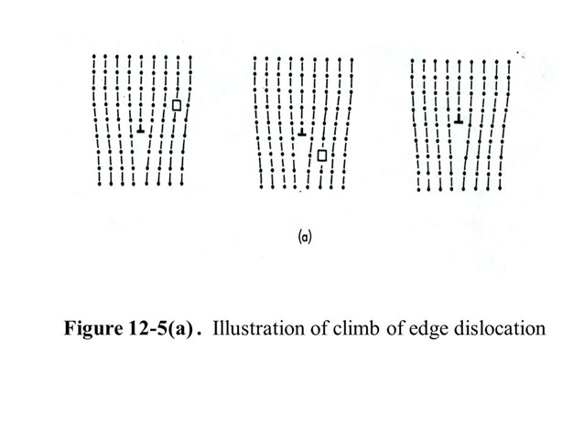
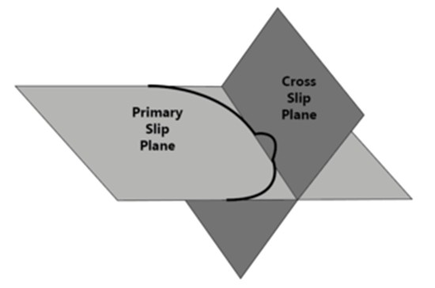
Climb
Cross slip

Slide 33
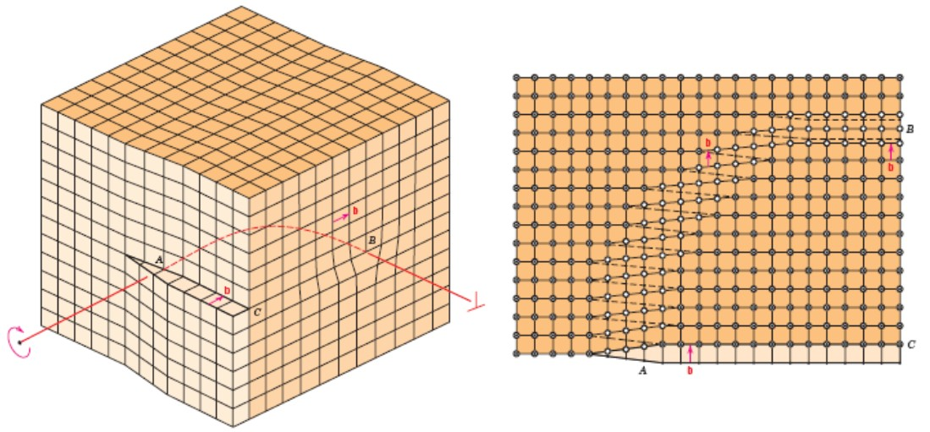
Edge, Screw, and Mixed Dislocations
Mixed
Edge
Screw

Slide 34
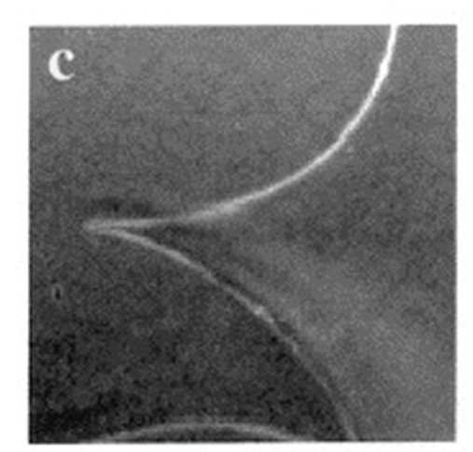
TEM image of curved dislocation line with mixed character.

Slide 35
A dislocation whose Burgers vector is a lattice translation vector is known as a perfect or unit dislocation.
Dislocations tend to have as small a Burgers vector as possible.
Dislocations are non-equilibrium defects and would leave the crystal if given an opportunity.

Slide 36
Line Defects
Dislocations:
• slip between crystal planes result when dislocations move
• produce permanent (plastic) deformation.
Schematic of Zinc (HCP):
• before deformation
• after tensile elongation
slip steps

Slide 37
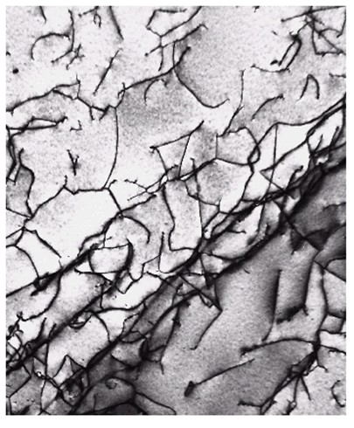
Characterization of dislocations
Dislocations can be observed using transmission electron microscopy, field ion microscopy, scanning tunneling microscopy and atom probe techniques
Dislocations are visible in electron micrographs

Slide 38
Planar Defects
External Surface
Grain Boundary
Twin Boundary
Phase Boundary
Stacking Fault
Domain Boundary
Anti Phase Boundary

Slide 39
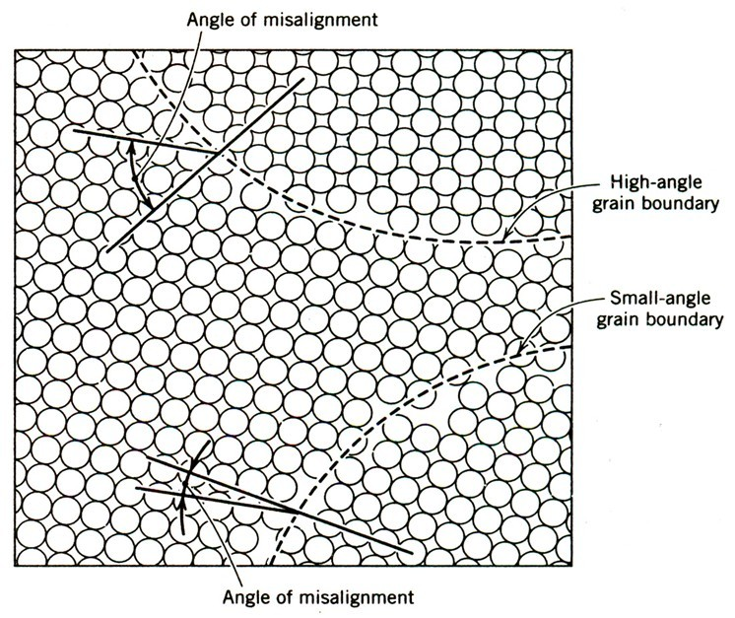
Grain Boundary
Crystals of different orientations meet.
A single-phase interface, with crystals on each side of the boundary being identical except in orientation.

Slide 40
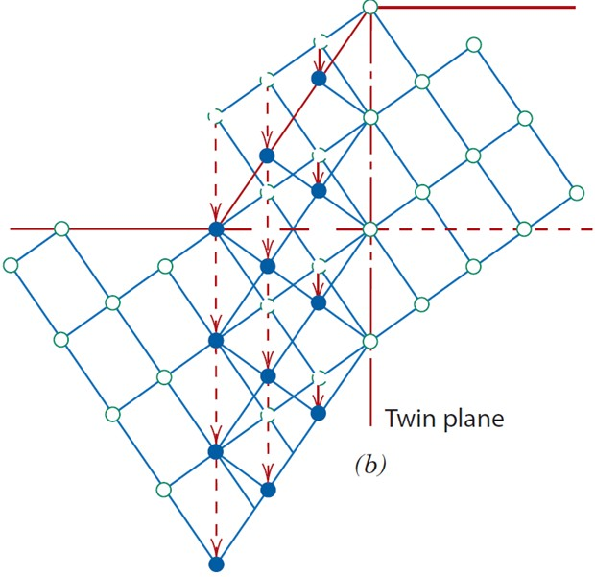
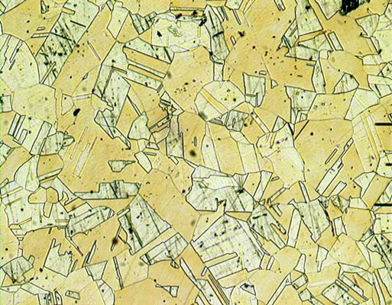
Twin Boundary
Essentially a reflection of atom positions across the twin plane
Twinned structure : Typical characteristics – always parallel lines are present

Slide 41
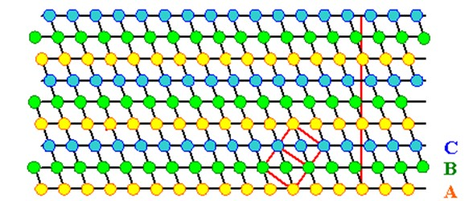
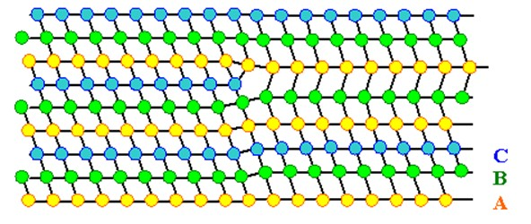
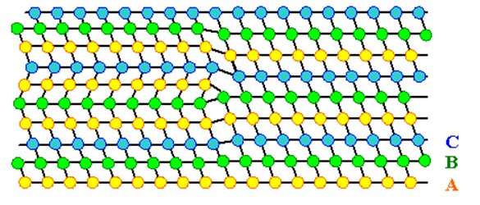
Stacking Fault
ABCABCABCA...
ABCABABCA...
"intrinsic stacking fault“
Removal of layer C
ABCABACABCA...
"extrinsic stacking fault“
Insertion of layer A

Slide 42
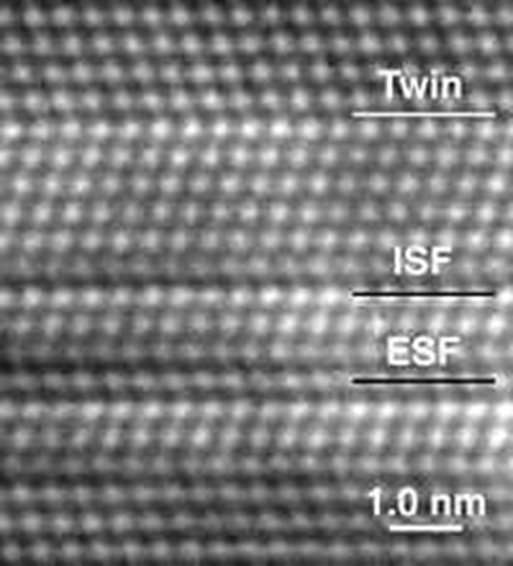
HRTEM image of defects
HRTEM (high-resolution TEM) image shows the atomic structure of planar defects in thin-film silicon:
a twin defect
an intrinsic stacking fault (ISF)
an extrinsic stacking fault (ESF—in which there is an intervening layer between two layers slightly shifted from each other)

Slide 43
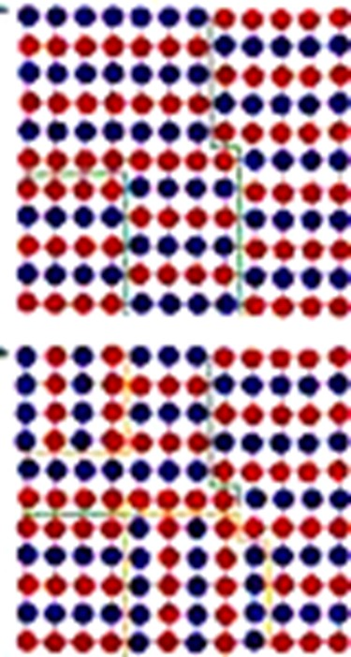
Anti Phase Boundary
occur in ordered alloys
The crystallographic direction remains the same
If the ordering is usually ABABABAB, an anti phase boundary takes the form of ABABBABA.

Slide 44
Bulk defects
Voids are small regions where there are no atoms, and can be thought of as clusters of vacancies.
Impurities can cluster together to form small regions of a different phase. These are often called precipitates.
Cracks, other phases also fall in this category.

Slide 45
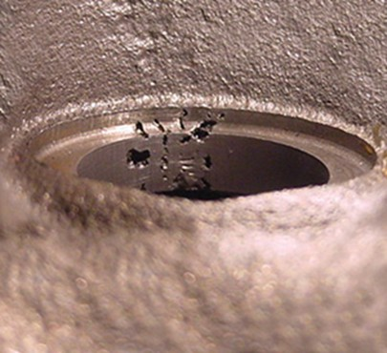
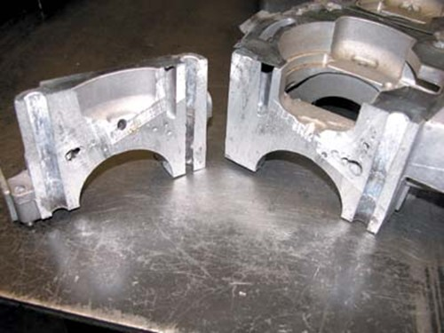
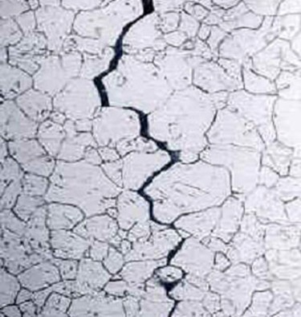
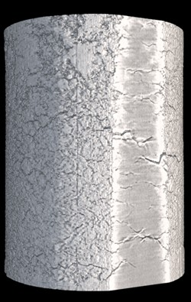
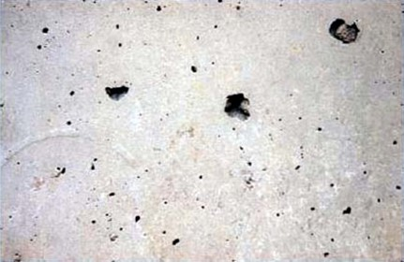
Volume defects

Slide 46
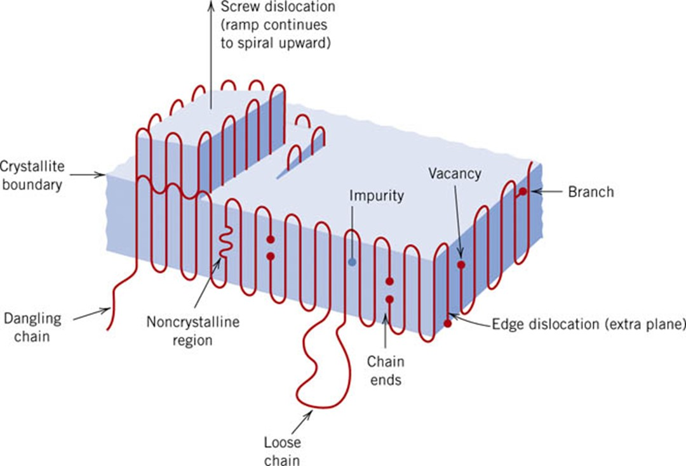
f14_15_pg515
Imperfections in Polymers
Notes:
f14_15_pg515.jpg

Slide 48
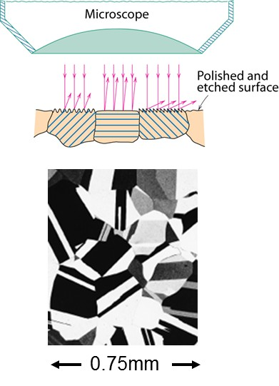
Optical Microscopy
• Useful up to 2000X magnification.
• Polishing removes surface features (e.g., scratches)
• Etching changes reflectance, depending on crystal
orientation.
crystallographic planes
Micrograph of
brass (a Cu-Zn alloy)

Slide 49
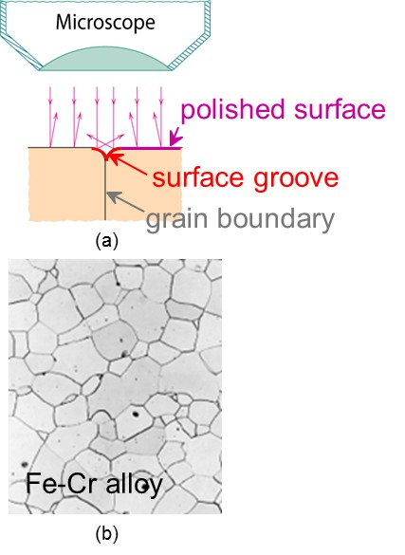
Optical Microscopy
Grain boundaries...
• are imperfections,
• are more susceptible
to etching,
• may be revealed as
dark lines,
• change in crystal
orientation across
boundary.
ASTM grain
size number
N
= 2
n
-1
number of grains/in²
at 100x
magnification

Slide 50
Microscopy
Optical resolution ca. 10⁻⁷ m = 0.1 μm = 100 nm
For higher resolution need higher frequency
Electrons
Wavelengths ca. 3 pm (0.003 nm)
Atomic resolution possible
Electron beam focused by magnetic lenses.

Slide 51
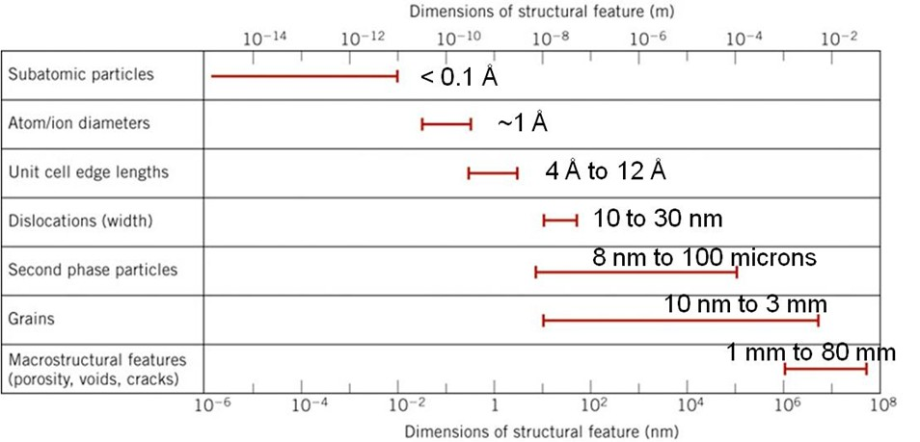
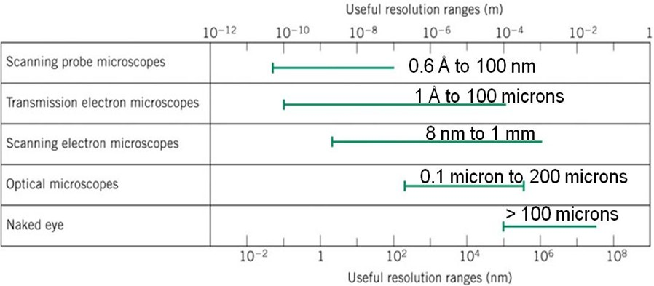
f15a_04_pg102
Notes:
f15a_04_pg102.jpg

Slide 52
Next Topic
Deformation and Strengthening Mechanisms

